Slide 1
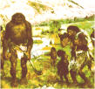
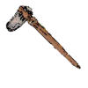
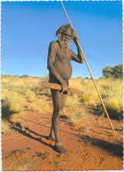
Pre-history – before anything was written down. The Stone Age - Cave men- Hunter Gatherers- the first inventions.
8000 BC the invention of agriculture leads to towns, writing and classes of people.
Thousands of years BC...
The Inuit or Eskimo as they used to be know used to expect anyone who could not help with feeding the tribe to go off and die
A Northern Territory Aborigine Band was reported to have carried a disabled woman member of their band with them on their travels for 60 years.

Slide 2
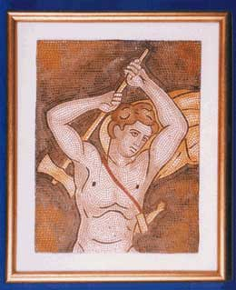
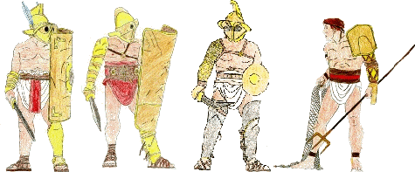
Ancient Greeks. Roman Empire stretches from Spain to Persia (Iran), from Scotland to Africa.
About 600BC Onwards...
Aristotle, in Ancient Greece said that Disabled Children should be left on a cliff top for a number of days to see if the Gods would accept them. If they survived they were accept
.
The Disabled were victims of the violent entertainment of Ancient Rome- short people or blind gladiators fighting women or wild animals. Disabled children thrown under chariots in the Coliseum
Hephaestus was a Greek god who lived on Mount Olympus. Son of Zeus and Hara he was the blacksmith. He was disabled. His parents tried to drown him, but he was immortal. He married Aphrodite goddess of love and was a great lover, but thebutt of jokes.
Hephaestus returns to Olympus.

Slide 3
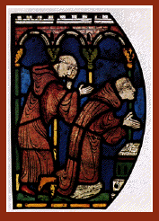
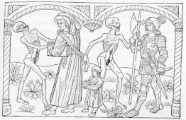
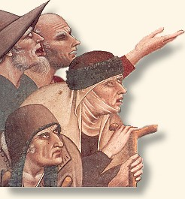
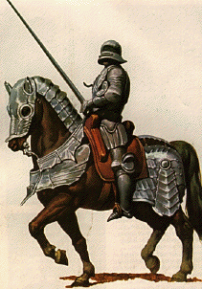
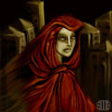
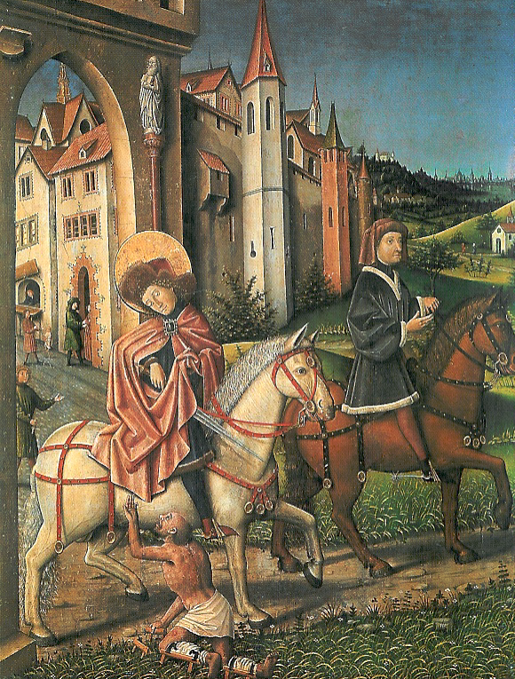
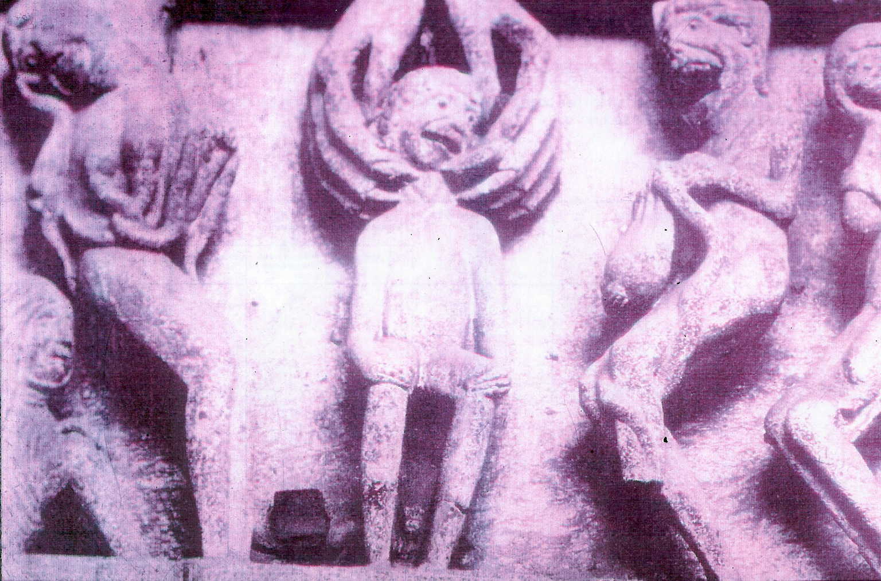
Growth of Christianity & Islam… Feudal Life Mainly Rural Life…Knights Plague Famine
Rural communities, families working together including disabled members. Spread of Christian values means those unable to work the land are supported by charity from local communities and monasteries, along with the very poor. But they are often seen in a negative light, as plague
carriers for example.
Middle Ages, 5thC AD to around 1400 ...
St Martin
of Tour cuts his cloak
Gargoyles outside churches

Slide 4
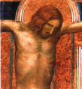
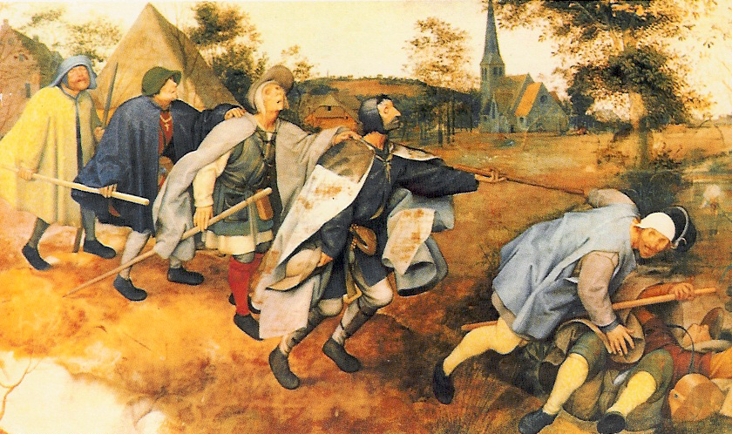
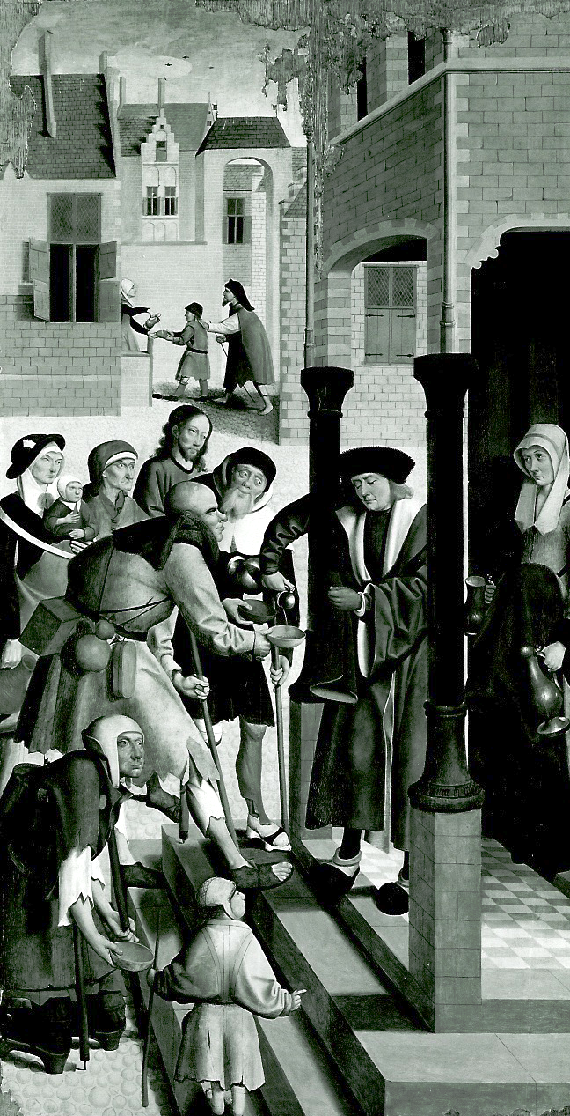
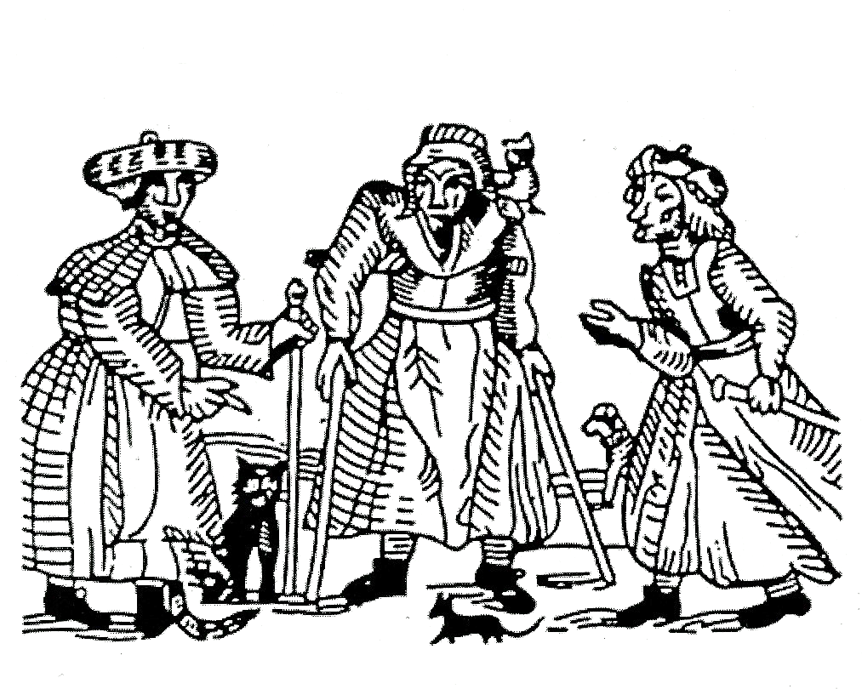
…
Age of Discovery The Renaissance Witch Hunts Revolution
Religious changes and conflict Shakespeare
Early Modern Period, 1400's - 1700's
.
Some religious views see disability as the result of a punishment from God, or sometimes as possession by demons and bad spirits. Related to witchcraft, disabled people victims of witch-hunts, when the more vulnerable members of society were often targeted.
Right. Witch Trial Oxford 1613
Disabled People made into beggars as ‘penitent sinners’. Left. Holland 1600.
Figures of Fun Far Right.

Slide 5
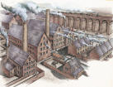
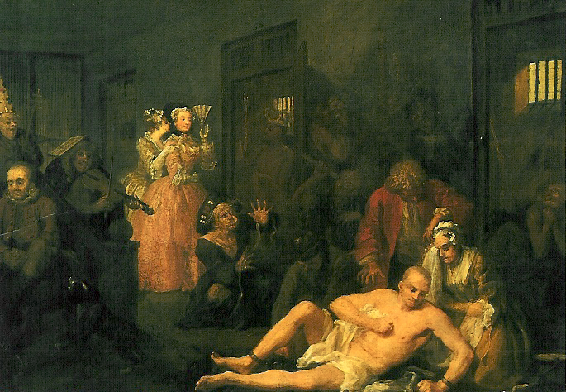
Industrial Revolution, people moving to towns…European World Domination…Growth in Invention, Design, Architecture, Technology… Growth of Socialism and Nationalism Industrial Revolution, people moving to towns… European World Domination
1800s
Industrial Revolution and urbanisation changes attitudes to the poor.
1830 Poor Law Reform Act – Sets up workhouses, disabled seen as ‘Worthy poor’.
1850 Asylum Act – places of refuge for those with mental illness.
1870 – The British Eugenics Society. Darwin’s theories applied to society, to ‘keep the race strong’.
1881 – Sign Language Banned in 21 countries. Thought deaf people would breed quicker if they had their own language.
1899 – National League of the Blind & Disabled.

Slide 6
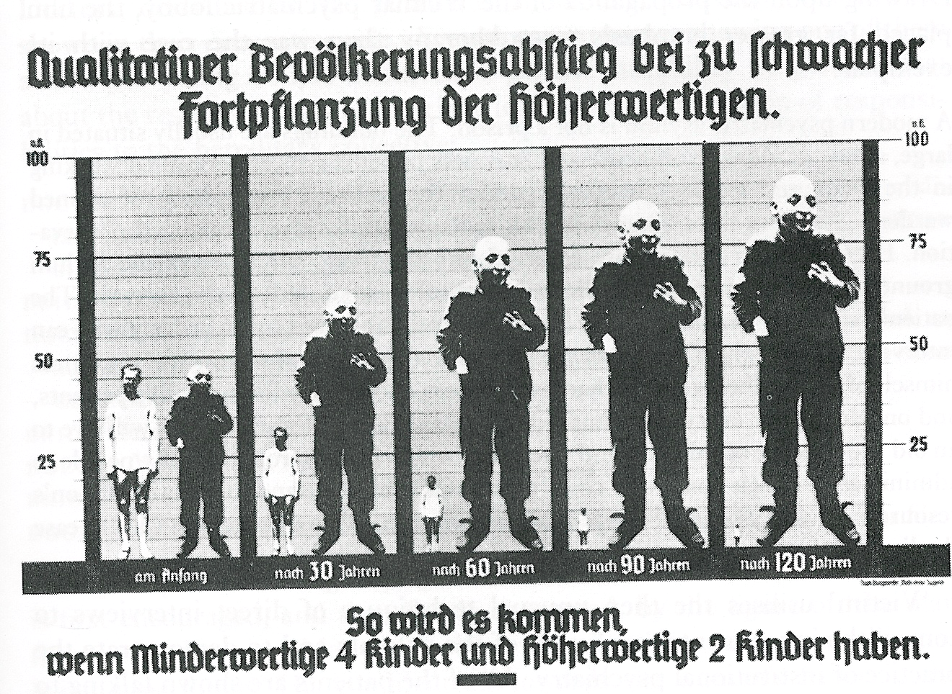
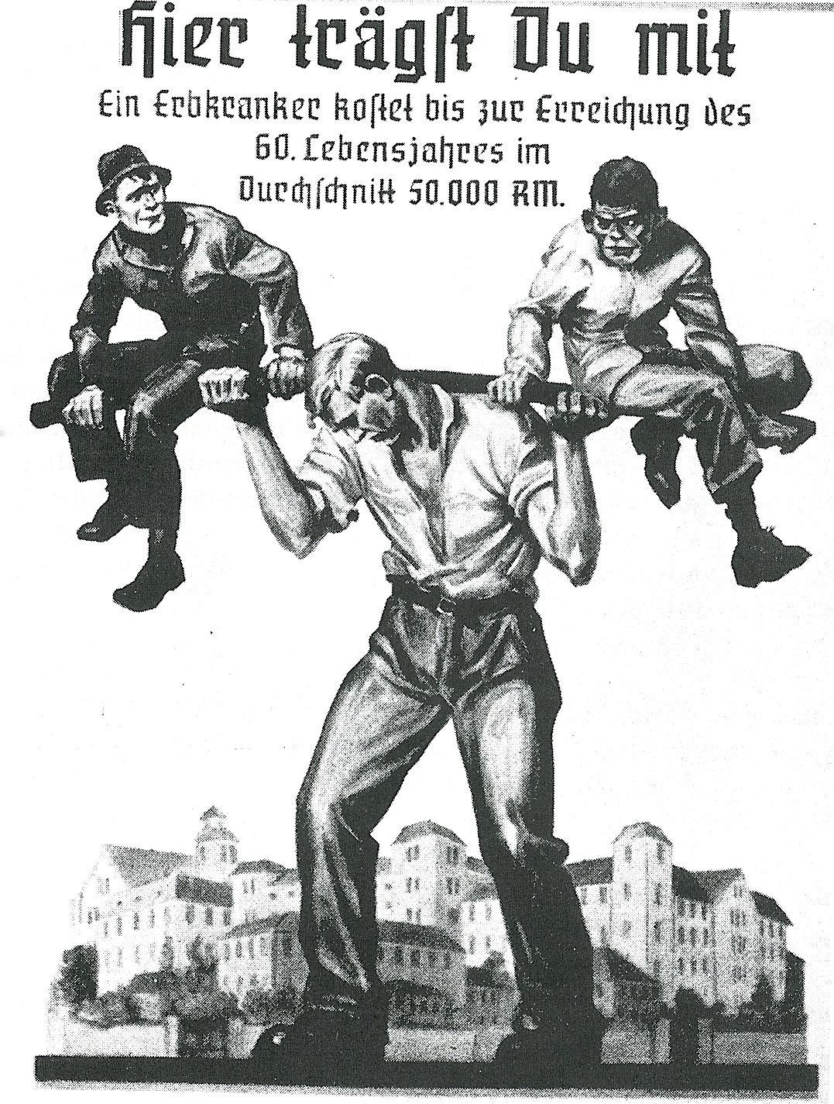
First Half of the 20th Century...
Mental Deficiency Act – people labelled as ‘Idiots’, ‘Imbeciles’, ‘Feebleminded’. Hospitals set up after WW1 where 500,000 people were
kept against their will.
1920’s & 1930’s, America & Germany - Compulsory sterilisation so cannot have children.
Nazi Euthanasia programme in Germany results in murder of 240,000 disabled adults and children in Nazi Germany.-
Euthanasia

Slide 7
Atom Bomb… United Nations… Civil Rights and Liberation Movements… Genocide… New World Order… Cold War…
Second Half of the 20th Century...
1959 Mental Health Act – ends to detention for all except those who are a danger to themselves or others.
1950’s & 60’s – Children Below 50 in IQ tests went to separate schools for ‘Educationally Sub-normal’.
1970’s – Care in the Community. ‘People First’ Formed in Canada.
1981 – Disabled People’s International formed. 1990’s – Disabled People’s Movement. Warnock Report
2000 – Curriculum for all children. General Inclusion Statement.
2001 – SEN & Disability Bill.

Slide 8
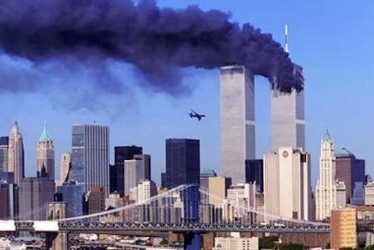
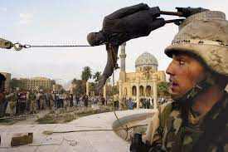
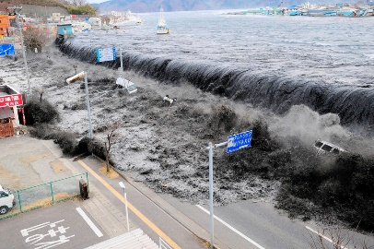
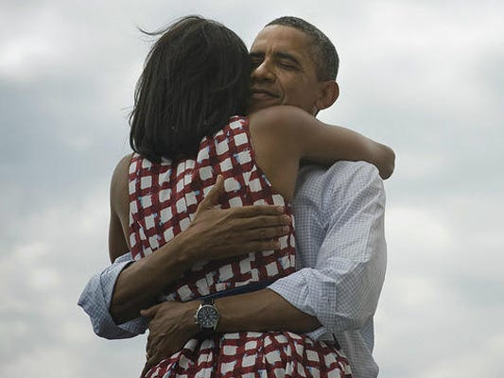
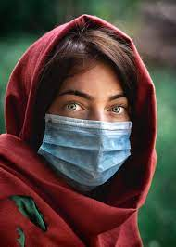
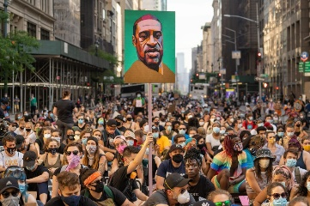
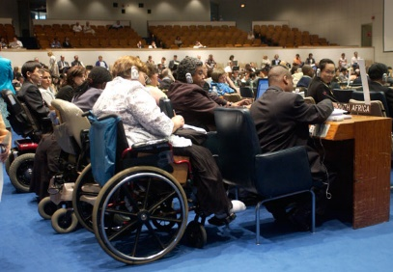
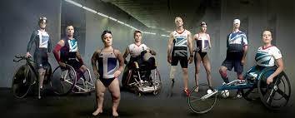
Gulf of Mexico
Japan Tsunami
Obamas
Covid
Black Lives Matter
Twin Towers
Iraq
21st Century 2000 to 2022 ???????
Covid Hardest Hit
Most at risk Eco Catastrophic Events
Austerity
Paralympics 2012

