Slide 1
UK Disability History Month
Prominent Disabled Black leaders
18th November 2019
By Michelle Daley
Notes:
I will focus on 3 women from the UK to highlight the contributions to equality for all people

Slide 2
Disabled Black Leaders You Didn’t Learn About
We too… fought against oppression, desegregation of education, independent living, decent healthcare, travel, employment opportunities, accessible homes, decent laws and so on.
Notes:
Picture of Barbara Stewart hands. Barbara was a poet and community activist. She was also known for her work on disability hate crime.

Slide 3
Mary Prince
“We don't mind hard work, if we had proper treatment, and proper wages like English servants, and proper time given in the week to keep us from breaking the Sabbath. But they won't give it: they will have work-work-work, night and day, sick or well, till we are quite done up; and we must not speak up nor look amiss, however much we be abused. And then when we are quite done up, who cares for us, more than for a lame horse? This is slavery. I tell it, to let English people know the truth.”
Mary Prince, The History of Mary Prince (1831)

Slide 4
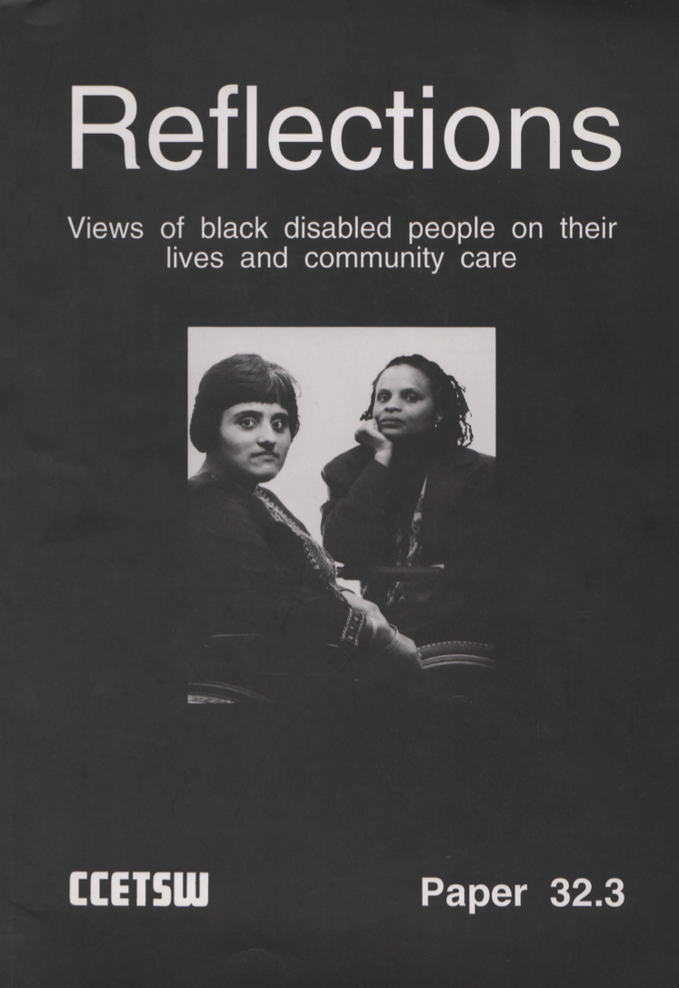
Nasa Begum and Millie Hill
Millie said: “One of my primary concern is still trying to reach black disabled people, and whereas the white disability movement is really moving full steam ahead, I still see very few black people actively involved in the movement. A lot of this is historical because of the way the organisations have been build up. They have been led primarily by white people, white males mostly, and black disabled people are not automatically involved in them.”
Notes:
Millie’s comment taken from Disability Politic: Understanding Our Past, Changing Our Future written by Jane Campbell and Mike Oliver.

Slide 5
Audre Lorde
“There is no thing as a single-issue struggle because we do not live single-issue lives”

