Slide 1
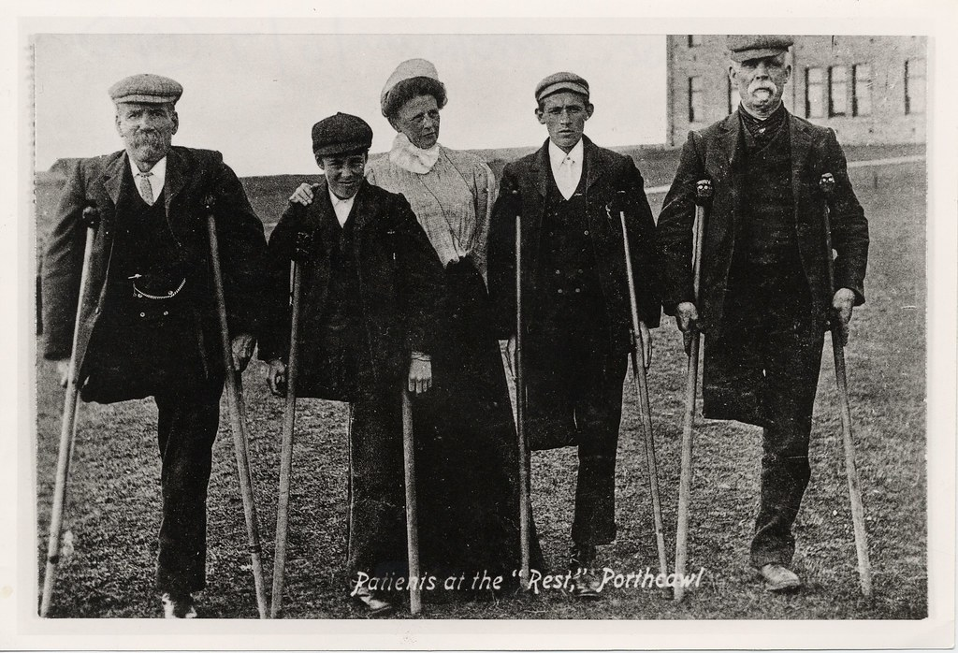
Disability, Employment and Livelihood
Historical Perspectives
Professor David Turner

Slide 2
Before the Industrial Revolution
Disabled people expected to work if they were capable of doing so
Sometimes wages were supplemented by poor relief
E.g. Norwich census of the poor (1570): lists many disabled people working in the town’s woollen trade
‘Elizabeth Mason, widow … 80 year, a lame woman of one hand, & spin & wind with one hand’
Shoemaking, running errands/portering, shopkeeping, agricultural work
Some trades associated with physically disabled workers, e.g. knitting and tailoring

Slide 3
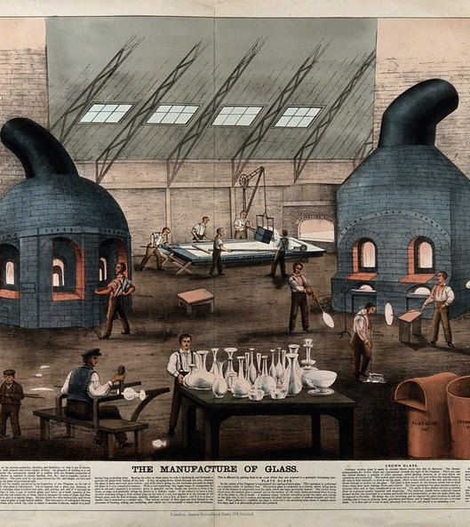
Disability and Industrialisation
Increased marginalisation?
Characteristics of ‘pre-industrial’ labour: work at home, to own pace, surrounded by family – more support?
Industrial labour: mechanisation (e.g. factories), increased speed, regulation of time, standardisation – disabled people excluded?
But in reality things much more complex
In 1851 30% of adults worked in manufacturing, but only 5% in factories
Disabled people still expected to work as far as they were capable of doing so!

Slide 4
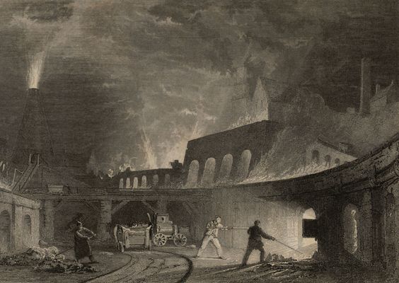
Disability and industrial society
Disability was a common sight and full health was abnormal in many industrial communities
E.g. morning Chronicle newspaper on Merthyr Tydfil, 1850:
‘the streets are thronged with the maimed and mutilated. In a distance of a hundred yards I once saw three men moving in different directions, two of whom had lost a leg and the other both legs. It is a frequent practice for men disabled in this manner to learn to play the harp, by which means they earn a precarious and scanty subsistence’

Slide 5
Disabled people’s work experiences
Not automatically excluded from heavy industry – e.g. many examples of disabled men working at coalmines
Some continued to work underground, others found jobs at the surface
Disability was an expected consequence of mining, so employers felt pressure to find men work
Sick and impaired people faced pressures to work: e.g. fear of workhouse, poverty expectation to contribute to family economy, threat of losing work to non-disabled workers
Enabling/disabling factors: attitude of employers, availability of variety of employment, family support, individual impairments

Slide 6
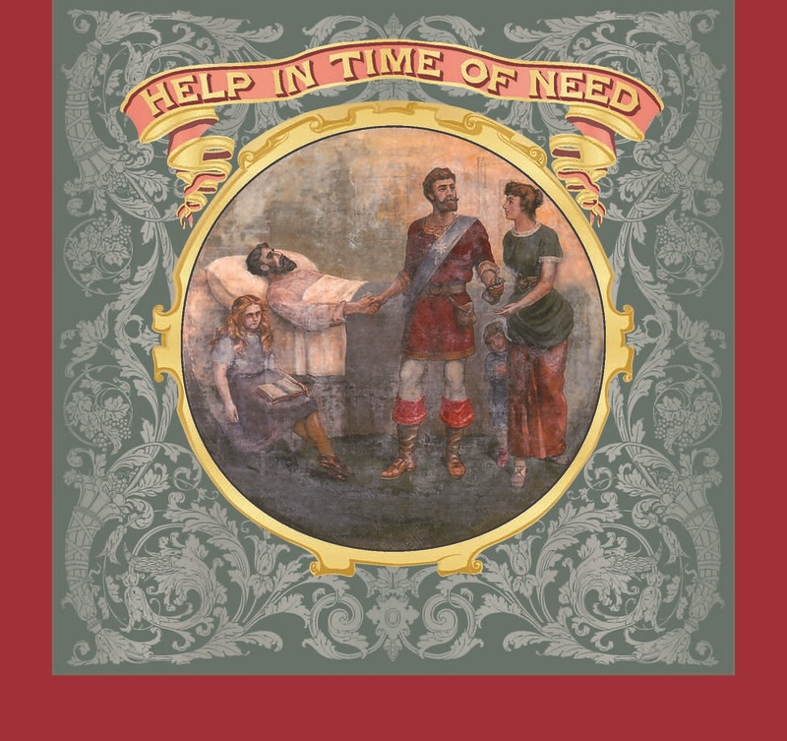
Solidarity and Support
In dangerous industries such as mining, disablement was a spur to growth of trade unions
By 20th century unions played important role in fighting for compensation for disabled miners
Friendly society membership also grew during 19th century
Tended to offer short term sickness relief (not geared towards permanent disablement)
Miners Permanent Relief Fund (established 1860s)

Slide 7
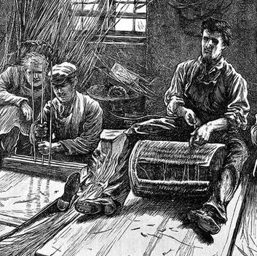
Change over time
Increasing activism and advocacy highlighted problems facing disabled workers, including prejudice
E.g. Association for Promoting the General Welfare of the Blind established in 1854 to address problem of blind adults’ unemployment
Jane Groom tried to establish a settlement in Manitoba during 1880s to liberate deaf Britons from the ‘social disabilities’ they faced finding work at home
1897 Workmen’s Compensation Act made employers more averse to hire older and/or disabled workers
Definition of ‘disabled’ as being incapable of doing paid labour evolved during the 19th century.

