Slide 1
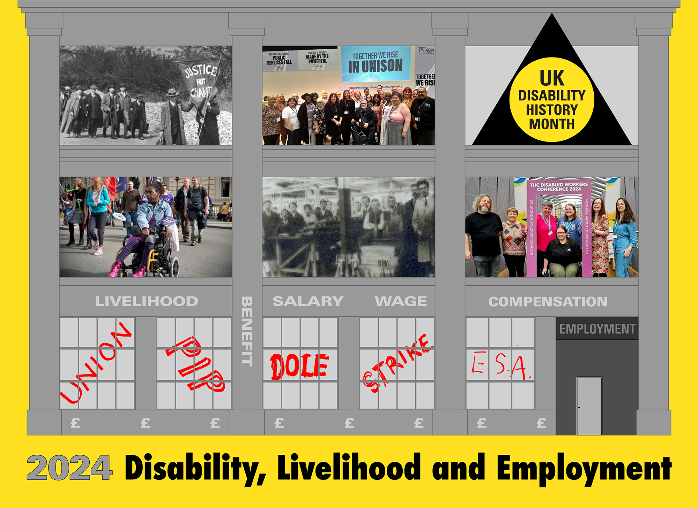

Slide 2

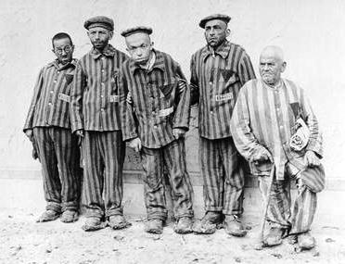

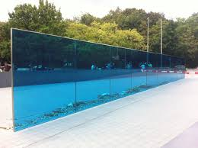
Logo Getting Rid of the ‘Useless Eaters’ in Nazi Germany 1933-1945
This led to 1 million disabled people being killed in Greater Germany by 1946 as a BURDEN

Slide 6
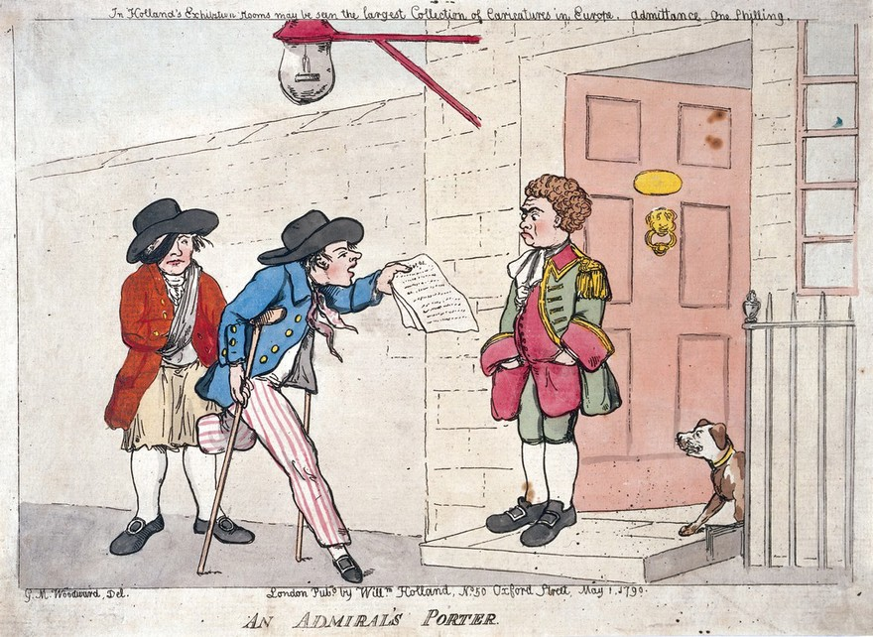
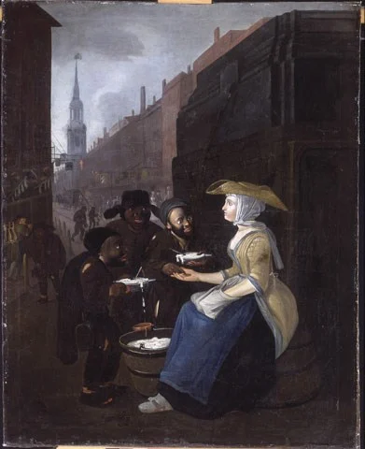
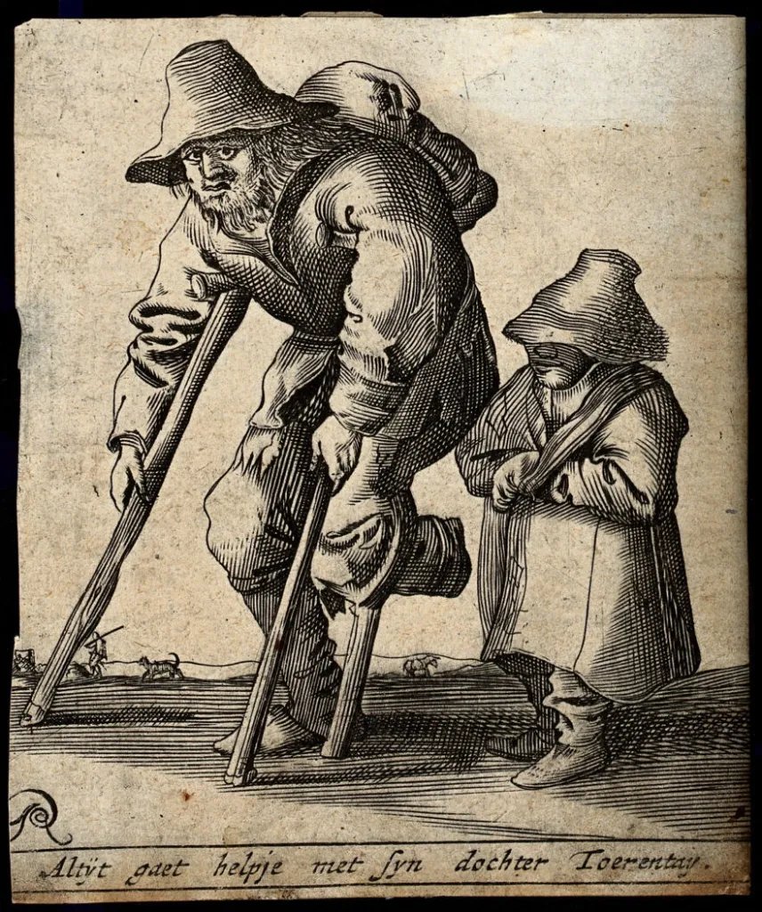
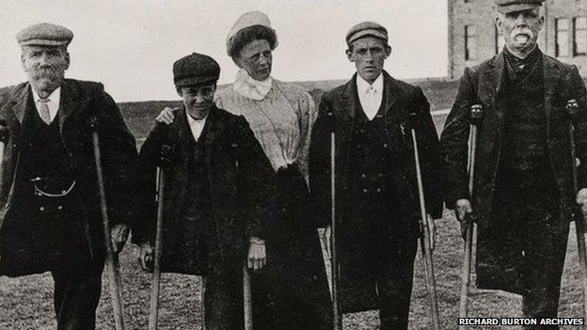
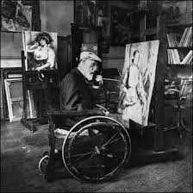
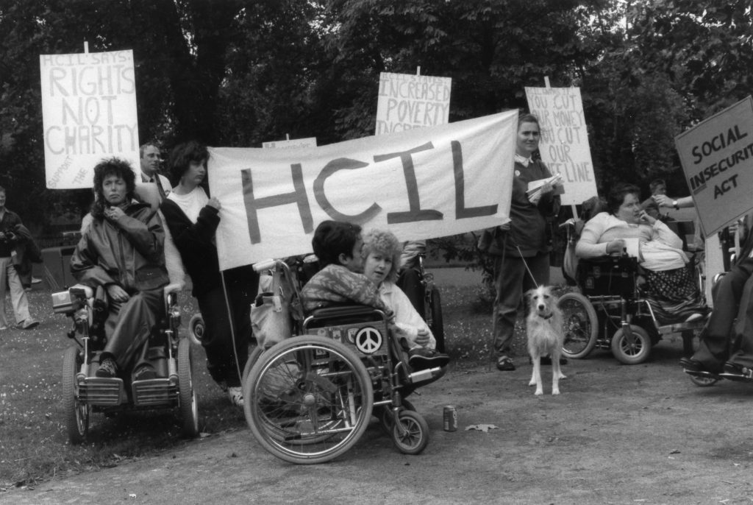
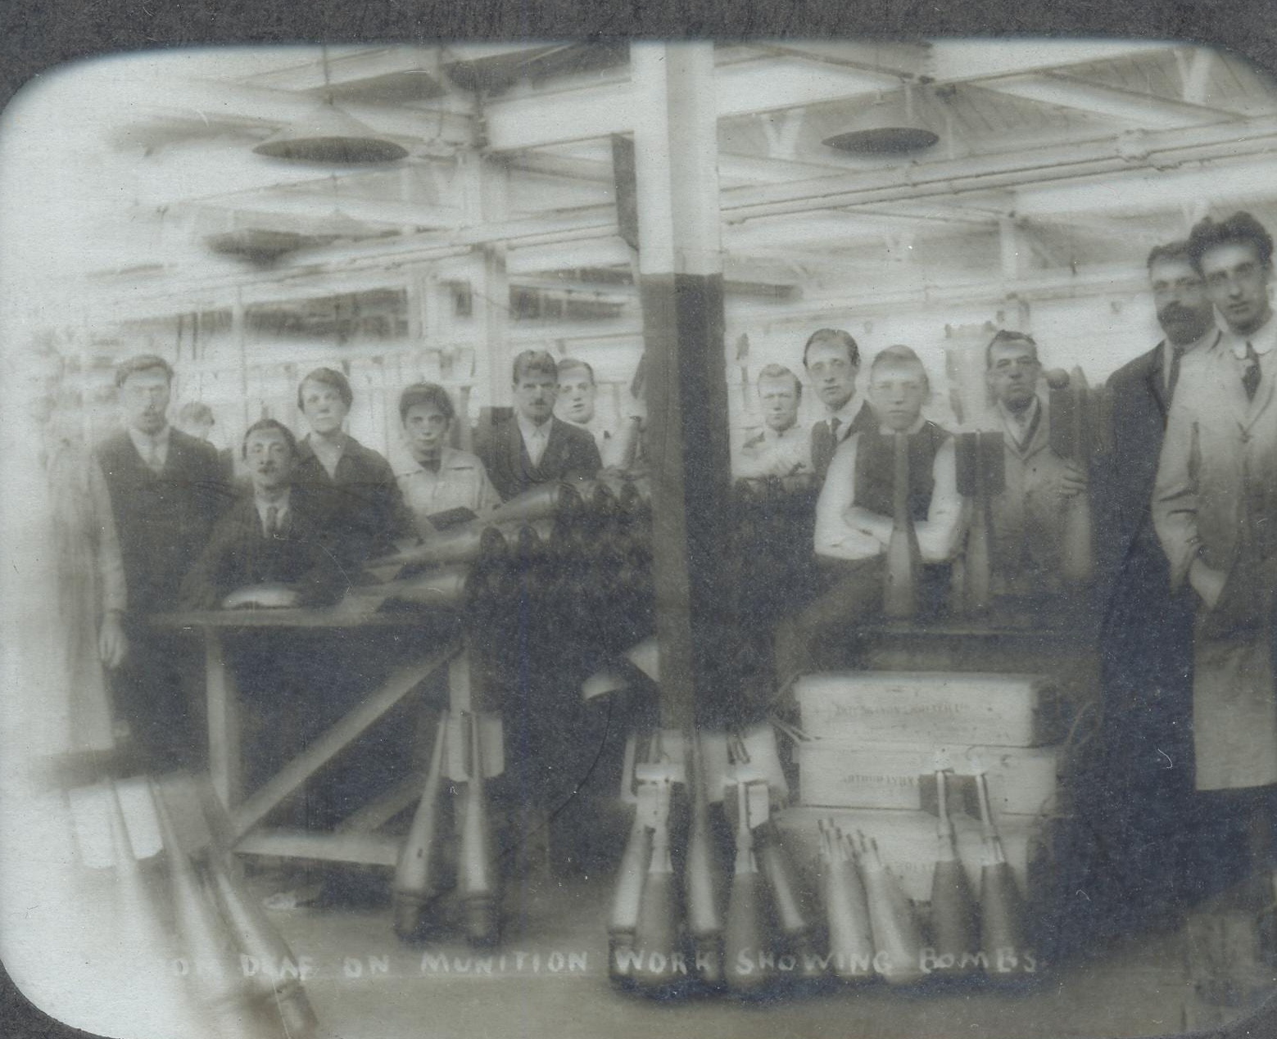
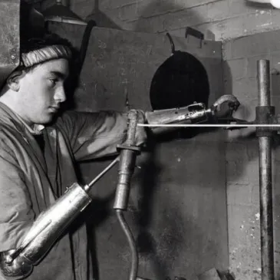
Disabled people have always sought a means of surviving in society. But attitudes change and new barriers emerge.
Disabled worker and daughter
on the tramp C18th
South Wales Miners supported South
Wales Miners Federation Rest Home
The Admiral’s Messenger
Blind Curds and Wey Seller C18th Cheapside
Hampshire Centre Independent Living 1988
Left female amputee riveter 1940 . Right Deaf Munitions workers 18914-18
Renoir Painting

Slide 7
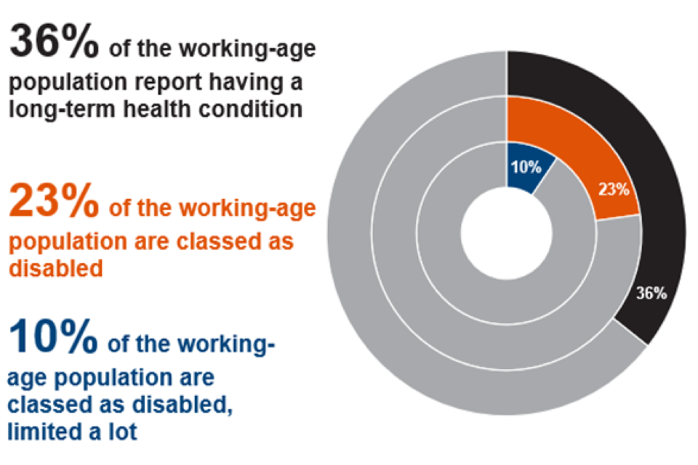
14.8 m -Proportion of the population with a long-term health condition, classed as disabled, including those limited a lot, people aged 16 to 64 years, UK, 2022/2023

Slide 8
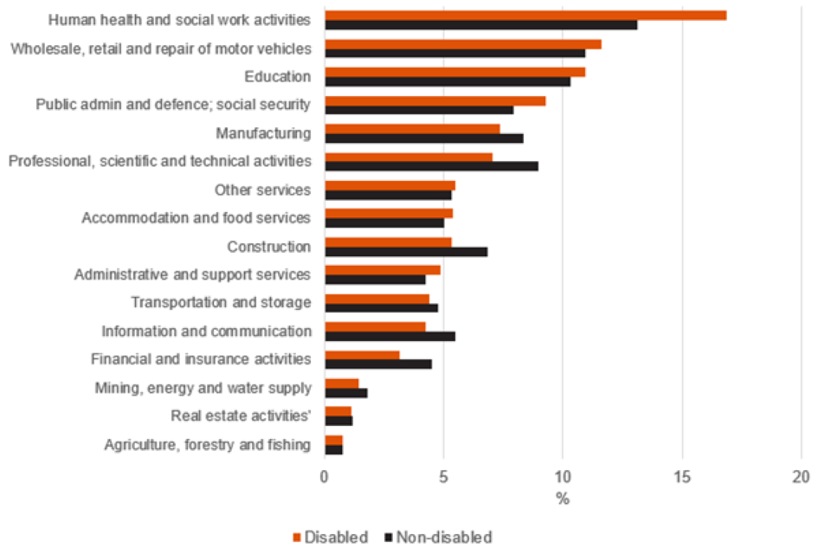
Disabled workers are more likely to work in the Health, Retail and Education industries
Figure 21: Percentage of people employed in each industry by disability status, people aged 16 to 64 years, UK, 2022/2023

Slide 9
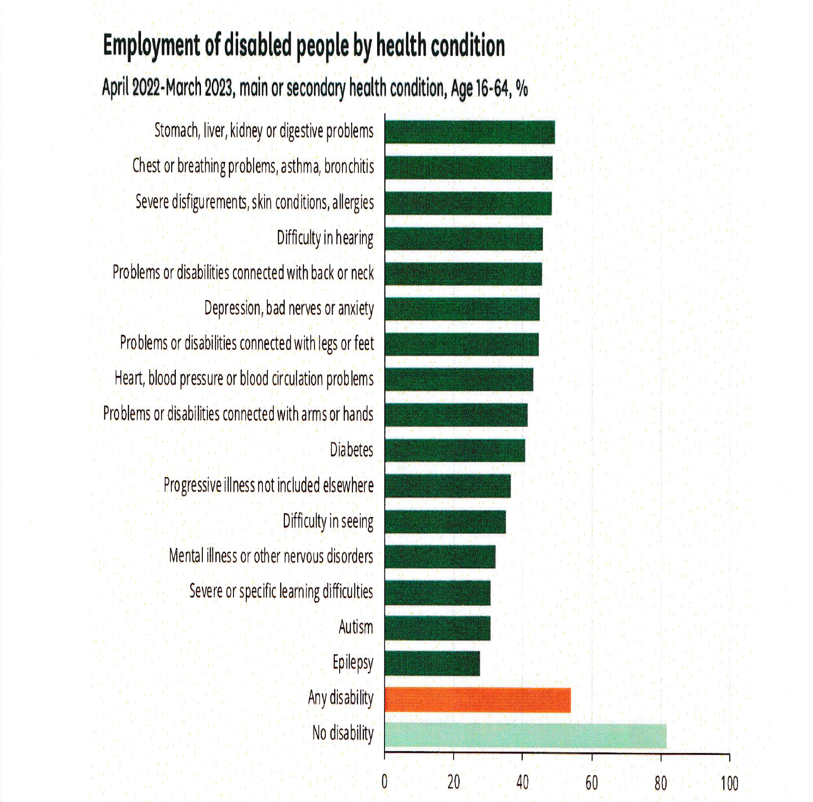
Proportion of people in employment by main health condition, people aged 16 to 64 years, UK, 2022/2023

Slide 10
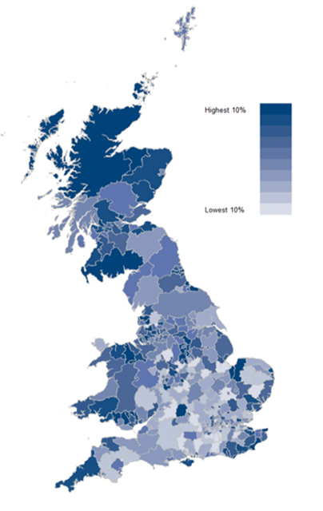
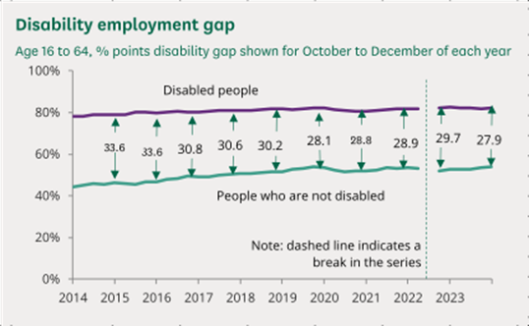

Slide 11
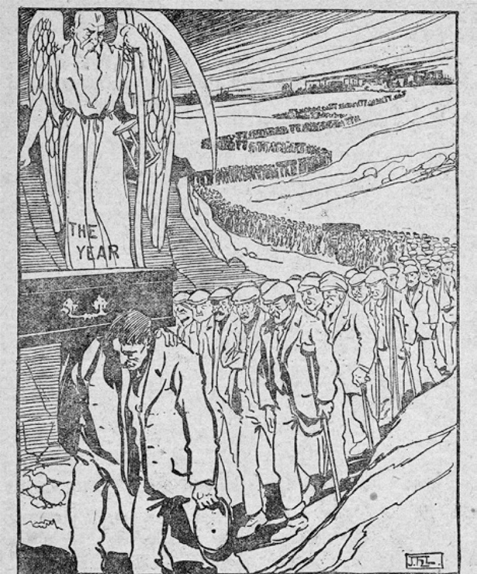
Labour Leader 1911 The Toll of Industry
‘During the year 1910, 3,474 persons were killed and 379,902 were disabled whilst at work. This means that if a procession were formed of the victims of industry, it would stretch 43½ miles with a corpse every twenty yards. Between each corpse 100 disabled workpeople would be marshalled, marching five abreast, and if the widows and orphans followed in the procession it would then be 45½ miles long. In each hundred disabled workpeople there would be approximately 45 miners, 41 factory workers, and
14 persons from the following occupations – railwaymen, seamen, dockers, quarrymen and those employed on works of construction.’

Slide 12
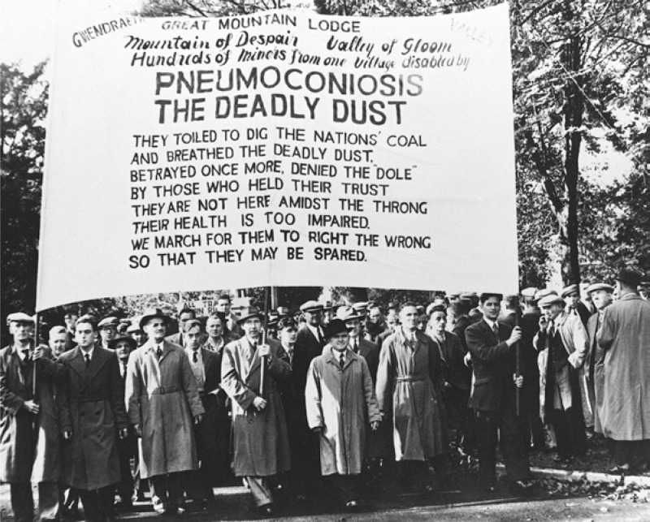
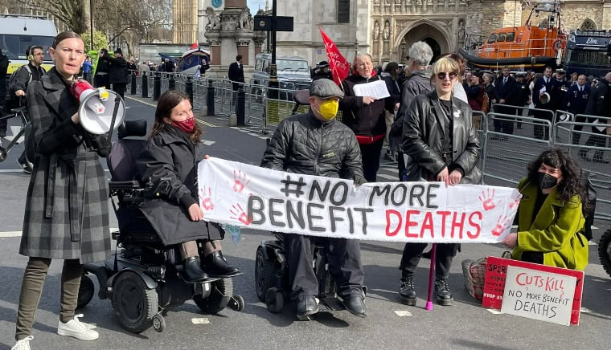


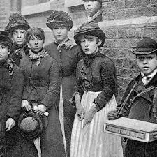
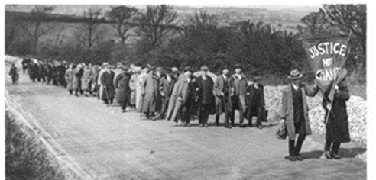


Resistance
DPAC 2024 No More Benefit Deaths
National League of the Blind 1920 March on London Justice not Charity.
1888 Match Girls strike

Slide 13
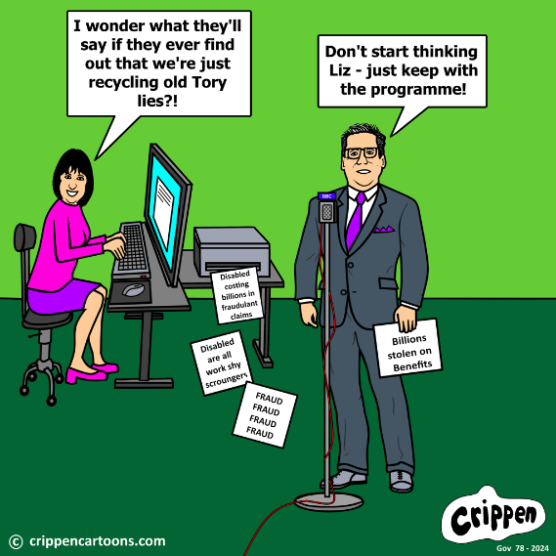
What is to be done?
1.Develop Inclusive Education and Training to develop disabled young people’s confidence
2. Give Equality Human Rights Commission stronger powers to implement disability equality
3. If in work join a union and champion reasonable accommodations for disabled colleagues
4. Tax incentives for employers positive about employing those with Autism and significant learning difficulty
5. Encourage traditional crafts as sustainable future employing more disabled people
6. Restore free access and legal aid to Employment Tribunals
7. Raise level of Benefits for those who can’t work. Taper benefits favourably to get into work
8. Big expansion Access to Work
UKDHM https://ukdhm.org

